Slide 1

第三讲
不对称分治递归渐进时间复杂度分析
随机算法期望时间复杂度分析
D-Select,R-Select
QuickSort

Slide 2
主要内容
复习主定理和替换法
k-SELECT problem
D-Select (确定性算法)
R-Select, QuickSort(随机算法)

Slide 3



The master theorem
We can also take n/b to mean either $\left\lfloor \frac{n}{b}\right\rfloor$ or $\left\lceil \frac{n}{b}\right\rceil$ and the theorem is still true.
Suppose that $a≥1,b>1,and d$ are constants (independent of n).
Suppose $T\left(n\right)=a⋅T\left(\frac{n}{b}\right)+O\left(n^{d}\right)$. Then
$$T\left(n\right)= \left\{\begin{aligned}O\left(n^{d}\log\left(n\right)\right) if a=b^{d} \\ O\left(n^{d}\right) if a<b^{d} \\ O\left(n^{\log_{b}\left(a\right)}\right) if a>b^{d}\end{aligned}\right.$$
Three parameters:
a : number of subproblems
b : factor by which input size shrinks
d : need to do n^{d} work to create all the subproblems and combine their solutions.
Many symbols those are….

Slide 4
The Substitution Method
Another way to solve recurrence relations.
More general than the master method.
Step 1: Generate a guess at the correct answer.
Step 2: Try to prove that your guess is correct.
(Step 3: Profit.)

Slide 5
The k-SELECT problem from your pre-lecture exercise
For today, assume all arrays have distinct elements.
A is an array of size n, k is in {1,…,n}
SELECT(A, k):
Return the k’th smallest element of A.
7
4
3
8
1
5
9
14
SELECT(A, 1) = 1
SELECT(A, 2) = 3
SELECT(A, 3) = 4
SELECT(A, 8) = 14
SELECT(A, 1) = MIN(A)
SELECT(A, n/2) = MEDIAN(A)
SELECT(A, n) = MAX(A)
Being sloppy about floors and ceilings!
Note that the definition of Select is 1-indexed…

Slide 6
On your pre-lecture exercise… An O(nlog(n))-time algorithm
SELECT(A, k):
A = MergeSort(A)
return A[k-1]
Running time is O(n log(n)).
So that’s the benchmark….
Can we do better?
It’s k-1 and not k since my pseudocode is 0-indexed and the problem is 1-indexed…
Show that you can’t do better than O(n).
We’re hoping to get O(n)

Slide 7
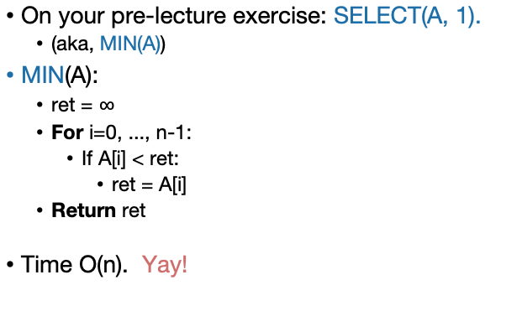
Goal: An O(n)-time algorithm
On your pre-lecture exercise: SELECT(A, 1).
(aka, MIN(A))
MIN(A):
ret = $∞$
For i=0, ..., n-1:
If A[i] < ret:
ret = A[i]
Return ret
Time O(n). Yay!
This loop runs O(n) times
This stuff is O(1)

Slide 8
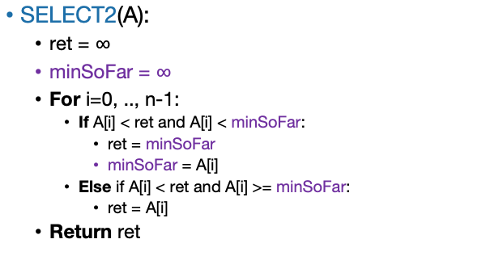
Also on your pre-lecture exercise How about SELECT(A,2)?
(The actual algorithm here is not very important because this won’t end up being a very good idea…)
SELECT2(A):
ret = $∞$
minSoFar = $∞$
For i=0, .., n-1:
If A[i] < ret and A[i] < minSoFar:
ret = minSoFar
minSoFar = A[i]
Else if A[i] < ret and A[i] >= minSoFar:
ret = A[i]
Return ret
Still O(n)
SO FAR SO GOOD.

Slide 9
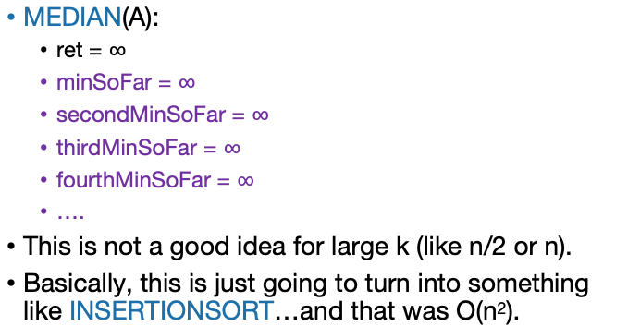
SELECT(A, n/2) aka MEDIAN(A)?
MEDIAN(A):
ret = $∞$
minSoFar = $∞$
secondMinSoFar = $∞$
thirdMinSoFar = $∞$
fourthMinSoFar = $∞$
….
This is not a good idea for large k (like n/2 or n).
Basically, this is just going to turn into something like INSERTIONSORT…and that was O(n²).

Slide 10
Idea: divide and conquer!
Say we want to find SELECT(A, k)
9
8
3
6
1
4
2
9
8
3
6
1
4
2
How about this pivot?
First, pick a “pivot.”
We’ll see how to do this later.
This PARTITION step takes time O(n). (Notice that we don’t sort each half).
Next, partition the array into “bigger than 6” or “less than 6”
L = array with things smaller than A[pivot]
R = array with things larger than A[pivot]

Slide 11
Idea: divide and conquer!
Say we want to find SELECT(A, k)
6
6
How about this pivot?
First, pick a “pivot.”
We’ll see how to do this later.
This PARTITION step takes time O(n). (Notice that we don’t sort each half).
Next, partition the array into “bigger than 6” or “less than 6”
3
1
4
2
9
8
L = array with things smaller than A[pivot]
R = array with things larger than A[pivot]

Slide 12
Idea continued…
Say we want to find SELECT(A, k)
6
3
1
4
2
pivot
9
8
L = array with things smaller than A[pivot]
R = array with things larger than A[pivot]
If k = 5 = len(L) + 1:
We should return A[pivot]
If k < 5:
We should return SELECT(L, k)
If k > 5:
We should return SELECT(R, k – 5)
This suggests a recursive algorithm
(still need to figure out how to pick the pivot…)

Slide 13
Pseudocode
getPivot(A)returns some pivot for us.
How?? We’ll see later…
Partition(A,p) splits up A into L, A[p], R.
See Lecture 4 Python notebook for code
Select(A,k):
If len(A) <= 50:
A = MergeSort(A)
Return A[k-1]
p = getPivot(A)
L, pivotVal, R = Partition(A,p)
if len(L) == k-1:
return pivotVal
Else if len(L) > k-1:
return Select(L, k)
Else if len(L) < k-1:
return Select(R, k – len(L) – 1)
Base Case: If len(A) = O(1), then any sorting algorithm runs in time O(1).
Case 1: We got lucky and found exactly the k’th smallest value!
Case 2: The k’th smallest value is in the first part of the list
Case 3: The k’th smallest value is in the second part of the list

Slide 14
Does it work?
Convince yourself that Select is correct!
Check out the Python notebook for Lecture 4, which implements this with a bunch of different pivot-selection methods.
Seems to work!
Check out the lecture notes for a rigorous proof based on induction that this works, with any pivot-choosing mechanism.
It provably works!
Also, this is a good example of proving that a recursive algorithm is correct.

Slide 15
证明Select(A,k)是正确的
Base Case (n = 1), k=1, Select(A,k) = A[0]，正确
Inductive Step. Let i ≥ 2, and suppose that the inductive hypothesis holds for all n with 1≤n<i. Select(A,k) returns the k-th smallest element of A
Our goal is to show that it holds for n=i.
Suppose k< i, the pivot is p, the partitioned array are A<, A>.
Case 1, if p is the k-smallest.
Case 2, if |A<| > k, Select(A<,k) will return the correct answer from the hypothesis.
Case 3, if |A<| < k, Select(A >,k- |A<| -1) will return the correct answer from the hypothesis.
Conclusion: the inductive hypothesis holds for all n ≥ 1

Slide 16

What is the running time? Assuming we pick the pivot in time O(n)…
$T\left(n\right)= \left\{\begin{matrix}T\left(len\left(L\right)\right)+O\left(n\right) len\left(L\right)>k −1 \\ T\left(len\left(R\right)\right)+O\left(n\right) len\left(L\right)<k −1 \\ O\left(n\right) len\left(L\right)=k−1\end{matrix}\right.$
What are len(L) and len(R)?
That depends on how we pick the pivot…
What would be a “good” pivot?
What would be a “bad” pivot?
Think: one minute
Share: (wait) one minute
The best way would be to always pick the pivot so that len(L) = k-1. But say we don’t have control over k, just over how we pick the pivot.
Think-Share Terrapins

Slide 17



The ideal pivot
Apply here, the Master Theorem does NOT. Making unsubstantiated assumptions about problem sizes, we are.
We split the input exactly in half:
len(L) = len(R) = (n-1)/2
Let’s pretend that’s the case and use the Master Theorem!
$T\left(n\right)≤T\left(\frac{n}{2}\right)+O(n)$
So a = 1, b = 2, d = 1
$T\left(n\right)≤O\left(n^{d}\right)=O\left(n\right)$
Jedi master Yoda
Suppose $T\left(n\right)=a⋅T\left(\frac{n}{b}\right)+O\left(n^{d}\right)$. Then
$$T\left(n\right)= \left\{\begin{aligned}O\left(n^{d}\log\left(n\right)\right) if a=b^{d} \\ O\left(n^{d}\right) if a<b^{d} \\ O\left(n^{\log_{b}\left(a\right)}\right) if a>b^{d}\end{aligned}\right.$$
That would be great!

Slide 18
Random Select: RSelect(A, i)

Slide 19
The worst running time of RSelect
Say our choice of pivot doesn’t depend on A.
A bad guy who knows what pivots we will choose gets to come up with A.
2
1
3
pivot

Slide 20
The worst running time of RSelect
The partition use linear time, so in the worst case:
T (n) = T (n − 1) + Θ(n)
So there is:
T(n)≤c₁n+c₁(n−1)+c₁(n−2)+...+c₁ =c₁n(n+1)/2
At the same time
T(n)≥c₂n+c₂(n−1)+c₂(n−2)+...+c₂ =c₂n(n+1)/2.
We conclude that
T (n) = Θ(n²).

Slide 21
The distinction matters!
For this one I chose the worst possible pivot. Looks like O(n²).
MergeSort-based solution
This one is a random pivot, so it splits the array about in half.
Looks fast!
See Lecture 4 Python notebook for code that generated this picture.

Slide 22
How do we pick a good pivot?
Randomly?
That works well if there’s no bad guy.
But if there is a bad guy who gets to see our pivot choices, that’s just as bad as the worst-case pivot.
Aside:
In practice, there is often no bad guy. In that case, just pick a random pivot and it works really well!
(More on this next lecture)

Slide 23
主要内容
复习主定理和替换法
k-SELECT problem
D-Select (确定性算法)
R-Select, QuickSort(随机算法)

Slide 24
D-Select: How do we pick a good pivot?
For today, let’s assume there’s this bad guy.
Reasons:
This gives us a very strong guarantee
We’ll get to see a really clever algorithm.
Necessarily it will look at A to pick the pivot.
We’ll get to use the substitution method.
“Times Bounds for Selection,” by Manuel Blum (1995 Turing award), Robert W. Floyd (1978 Turing award), Vaughan Pratt, Ronald L. Rivest (2002 Turning award), and Robert E. Tarjan (1986 Turing award) (Journal of Computer and System Sciences, 1973).

Slide 25
Approach
First, we’ll figure out what the ideal pivot would be.
But we won’t be able to get it.
Then, we’ll figure out what a pretty good pivot would be.
But we still won’t know how to get it.
Finally, we will see how to get our pretty good pivot!
And then we will celebrate.

Slide 26
How do we pick our ideal pivot?
The ideal case is to pick the pivot to divide the input in half.
Aka, pick the median!
Median（中间数）: 第n/2大的数
Aka, pick SELECT(A, n/2)!
计算下列数102, 56, 34, 99, 89, 101, 10 的Median
需要先排序、再找中间数

Slide 27
How about a good enough pivot?
我们可以用近似的思路找一个近似的中间数.
Lemma*: The median of sub-medians is close to the median.
What we’ll use as the pivot
Ideal pivot
median of sub-medians
median of the whole thing
$$≈$$
sub-median
sub-median
sub-median
sub-median
sub-median

Slide 28
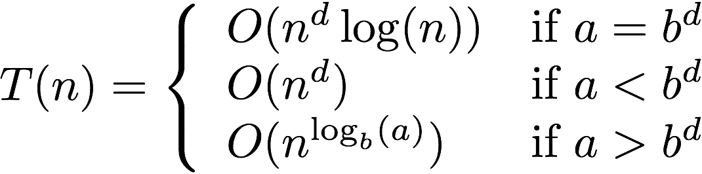
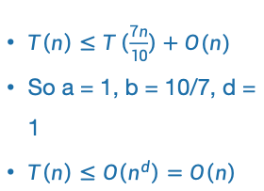
A good enough pivot
We still don’t know that we can get such a pivot, but at least it gives us a goal and a direction to pursue!
只要这个pivot不要太偏两边即可:
3n/10 < len(L) < 7n/10
3n/10 < len(R) < 7n/10
If we could do that (let’s say, in time O(n)), the Master Theorem would say:
Lucky the lackadaisical lemur
$T\left(n\right)≤T\left(\frac{7n}{10}\right)+O(n)$
So a = 1, b = 10/7, d = 1
$T\left(n\right)≤O\left(n^{d}\right)=O\left(n\right)$
Suppose $T\left(n\right)=a⋅T\left(\frac{n}{b}\right)+O\left(n^{d}\right)$. Then
STILL GOOD!

Slide 29


Goal
Efficiently pick the pivot so that
6
3
1
4
2
pivot
9
8
L = array with things smaller than A[pivot]
R = array with things larger than A[pivot]
$$\frac{3n}{10} < len\left(L\right)<\frac{7n}{10}$$
$$\frac{3n}{10} < len\left(R\right)<\frac{7n}{10}$$

Slide 30
基于近似中间数的pivot选择
We can’t solve SELECT(A,n/2) (yet)
But we can divide and conquer and solve SELECT(B,m/2) for smaller values of m (where len(B) = m).
Lemma*: The median of sub-medians is close to the median.
Ideal pivot
What we’ll use as the pivot
median of sub-medians
median of the whole thing
$$≈$$
sub-median
sub-median
sub-median
sub-median
sub-median
*we will make this a bit more precise.

Slide 31
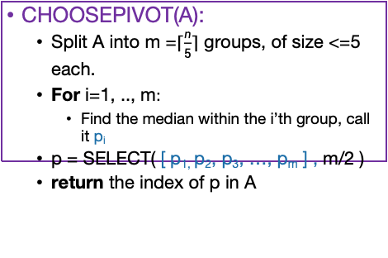
How to pick the pivot
CHOOSEPIVOT(A):
Split A into m =$\left\lceil \frac{n}{5}\right\rceil$ groups, of size <=5 each.
For i=1, .., m$:$
Find the median within the i’th group, call it p_{i}
p = SELECT( [ p_{1,} p₂, p₃, …, p_{m} ] , m/2 )
return the index of p in A
8
This takes time O(1) for each group, since each group has size 5. So that’s O(m)=O(n) total in the for loop.
4
12
2
1
5
20
1
8
9
3
15
5
9
1
3
4
5
15
13
2
4
6
12
1
15
22
3
6
8
4
5
6
12
Pivot is SELECT( , 3 ) = 6:
12
12
2
1
5
20
6
1
8
9
3
15
5
9
1
3
4
15
13
2
4
12
1
15
22
3
PARTITION around that 6:
6
1
3
5
1
3
4
2
1
2
4
1
3
5
8
9
15
9
12
20
15
13
12
15
22
This part is L
This part is R: it’s almost the same size as L.

Slide 32
CLAIM: this works divides the array approximately in half
Empirically (see Lecture 4 Python Notebook):

Slide 33
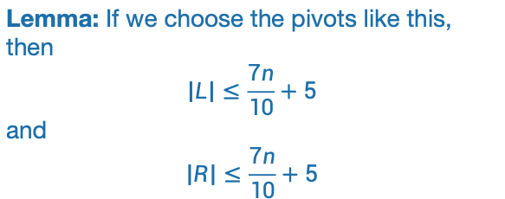
CLAIM: this works divides the array approximately in half
Formally, we will prove (later):
Lemma: If we choose the pivots like this, then
$$\left|L\right|≤\frac{7n}{10}+5$$
and
$$\left|R\right|≤\frac{7n}{10}+5$$

Slide 34
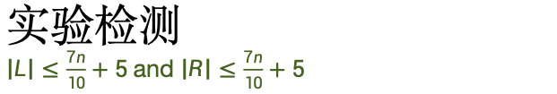
实验检测 $\left|L\right|≤\frac{7n}{10}+5$and $\left|R\right|≤\frac{7n}{10}+5$
在实际中，在随机数组中实际表现更好!
给出的是worst-case的界
That’s this window

Slide 35
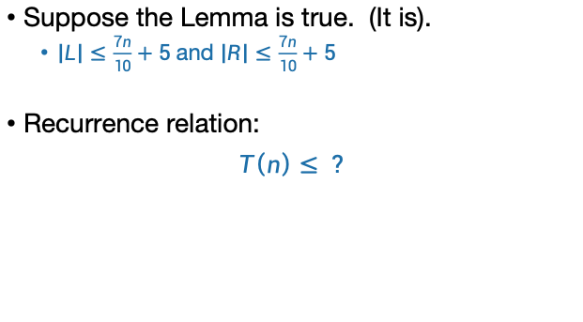
How about the running time?
Suppose the Lemma is true. (It is).
$\left|L\right|≤\frac{7n}{10}+5$and $\left|R\right|≤\frac{7n}{10}+5$
Recurrence relation:
$T\left(n\right)≤ ?$
估计一下大概是多少？
应该如何证明呢？

Slide 36

Pseudocode
Lemma says that $\left|L\right|≤\frac{7n}{10}+5$and $\left|R\right|≤\frac{7n}{10}+5$
Suppose Partition runs in time O(n)
Come up with a recurrence relation for T(n), the running time of Select, using the choosePivot algorithm we just described.
Select(A,k):
If len(A) <= 50:
A = MergeSort(A)
Return A[k-1]
p = choosePivot(A)
L, pivotVal, R = Partition(A,p)
if len(L) == k-1:
return pivotVal
Else if len(L) > k-1:
return Select(L, k)
Else if len(L) < k-1:
return Select(R, k – len(L) – 1)
Base Case: If len(A) = O(1), then any sorting algorithm runs in time O(1).
Case 1: We got lucky and found exactly the k’th smallest value!
Case 2: The k’th smallest value is in the first part of the list
Case 3: The k’th smallest value is in the second part of the list

Slide 37
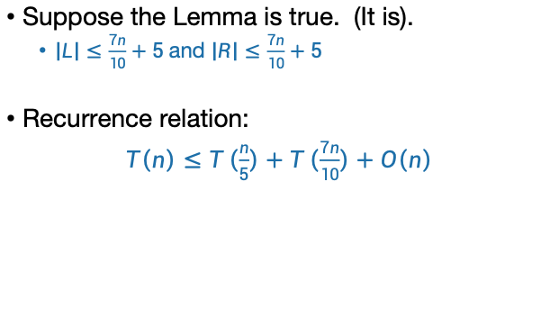
How about the running time?
Suppose the Lemma is true. (It is).
$\left|L\right|≤\frac{7n}{10}+5$and $\left|R\right|≤\frac{7n}{10}+5$
Recurrence relation:
$T\left(n\right)≤T\left(\frac{n}{5}\right)+T\left(\frac{7n}{10}\right)+O\left(n\right)$
对CHOOSEPIVOT的调用在大小为n/5的数组上再次递归调用SELECT。
Outside of CHOOSEPIVOT, there’s at most one recursive call to SELECT on array of size 7n/10 + 5.
We’re going to drop the “+5” for convenience,
but it does not change the final answer. Why?
Hint: Define T’(n) := T(n+1000) and write recurrence for T’
Siggi the Studious Stork

Slide 38
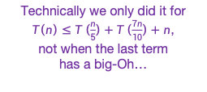


This sounds like a job for…
The Substitution Method!
Step 1: generate a guess
Step 2: try to prove that your guess is correct
Step 3: profit
$$T\left(n\right)≤T\left(\frac{n}{5}\right)+T\left(\frac{7n}{10}\right)+O(n)$$
我们上节课用替换法已经证明：
Technically we only did it for
$T\left(n\right)≤T\left(\frac{n}{5}\right)+T\left(\frac{7n}{10}\right)+n$,
not when the last term
has a big-Oh…
Conclusion: $T\left(n\right)=O\left(n\right)$
Plucky the Pedantic Penguin

Slide 39
When the last term has a big-Oh
We consider the recurrence
T(n) ≤ T(n/5) + T(7n/10) + cn
We guess:
To prove for n = k, we solve the following equation:
We can choose d = max (1, 10c ), and the proof is completed.

Slide 40
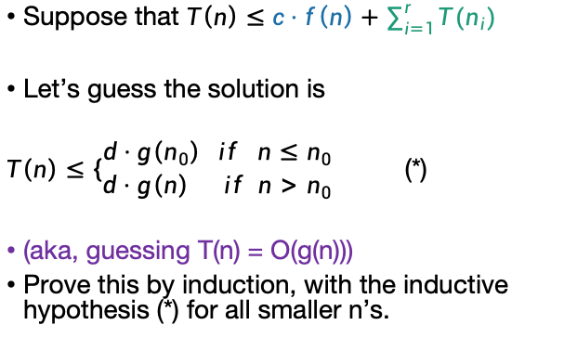
Substitution method
work to call recursive sub-problems and merge them back
Suppose that $T\left(n\right)≤c⋅f\left(n\right)+\sum_{i=1}^{r}{T(n_{i})}$
Let’s guess the solution is
$T\left(n\right)≤\left\{\begin{matrix}d⋅g\left(n_{0}\right) if n≤n_{0} \\ d⋅g\left(n\right) if n>n_{0}\end{matrix}\right.$ (*)
(aka, guessing T(n) = O(g(n)))
Prove this by induction, with the inductive hypothesis (*) for all smaller n’s.
Work in r different sub-problems, which might have different sizes.

Slide 41
Recap of approach
First, we figured out what the ideal pivot would be.
Find the median
Then, we figured out what a pretty good pivot would be.
An approximate median
Finally, we saw how to get our pretty good pivot!
Median of medians and divide and conquer!
Hooray!

Slide 42
分析思考
如果某个算法的时间复杂度的递推关系式如下，请分析算法的渐进时间复杂度
T(n) = T(n/100) + T(98n/100) + O(n)
T(n) = T(n/100) + T(48n/100) + O(1) 是O(log(n))的么？
T(n)= T(98n/100) + O(1) 是O(log(n))的么？

Slide 43
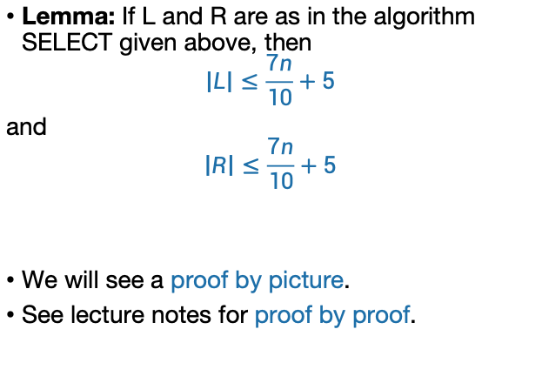
T(n) ≤ T(n/5) + T(7n/10) + cn 究竟是怎么来的?
Lemma: If L and R are as in the algorithm SELECT given above, then
$$\left|L\right|≤\frac{7n}{10}+5$$
and
$$\left|R\right|≤\frac{7n}{10}+5$$
We will see a proof by picture.
See lecture notes for proof by proof.

Slide 44
Proof by picture
1
5
2
3
6
8
18
10
13
7
5
9
4
7
70
17
3
6
12
4
22
15
35
11
2
m
Say these are our m = [n/5] sub-arrays of size at most 5.

Slide 45
Proof by picture
1
4
2
2
6
3
5
7
3
7
7
8
6
10
4
5
8
6
10
4
17
9
18
11
13
22
15
35
12
70
m
In our head, let’s sort them.
Then find medians.

Slide 46
Proof by picture
2
4
1
2
3
5
6
3
7
5
4
6
7
8
10
13
18
17
9
11
70
35
22
15
12
m
Then let’s sort them by the median

Slide 47
Proof by picture
2
4
1
2
3
5
6
3
7
5
4
6
7
8
10
13
18
17
9
11
70
35
22
15
12
m
The median of the medians is 7. That’s our pivot!

Slide 48
Proof by picture
We will show that lots of elements are smaller than the pivot, hence not too many are larger than the pivot.
2
4
1
2
3
5
6
3
7
5
4
6
7
8
10
13
18
17
9
11
70
35
22
15
12
m
How many elements are SMALLER than the pivot?

Slide 49
Proof by picture
2
4
1
2
3
5
6
3
7
5
4
6
7
8
10
13
18
17
9
11
70
35
22
15
12
m
At least these ones: everything above and to the left.

Slide 50
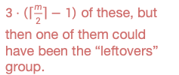

Proof by picture
$3⋅\left(\left\lceil \frac{m}{2}\right\rceil −1\right)$ of these, but then one of them could have been the “leftovers” group.
2
4
1
2
3
5
6
3
7
5
4
6
7
8
10
13
18
17
9
11
70
35
22
15
12
m
How many of those are there?
at least $3⋅\left(\left\lceil \frac{m}{2}\right\rceil −2\right)$

Slide 51


Proof by picture
2
4
1
2
3
5
6
3
7
5
4
6
7
8
10
13
18
17
9
11
70
35
22
15
12
m
So how many are LARGER than the pivot? At most…
$$n −1 −3\left(\left\lceil \frac{m}{2}\right\rceil −2\right)≤\frac{7n}{10}+5$$
Remember
$$m=\left\lceil \frac{n}{5}\right\rceil$$
(derivation on board)

Slide 52

That was one part of the lemma
Lemma: If L and R are as in the algorithm SELECT given above, then
$$\left|L\right|≤\frac{7n}{10}+5$$
and
$$\left|R\right|≤\frac{7n}{10}+5$$
The other part is exactly the same.

Slide 53


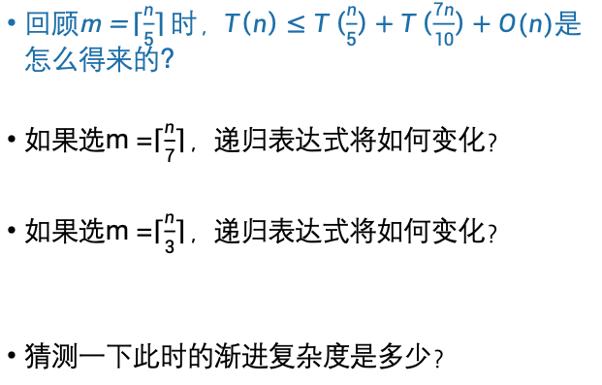
思考题
$回顾\text{m}\text{ =}\left\lceil \frac{n}{5}\right\rceil 时，T\left(n\right)≤T\left(\frac{n}{5}\right)+T\left(\frac{7n}{10}\right)+O(n)$是怎么得来的?
如果选m =$\left\lceil \frac{n}{7}\right\rceil$，递归表达式将如何变化？
如果选m =$\left\lceil \frac{n}{3}\right\rceil$，递归表达式将如何变化？
猜测一下此时的渐进复杂度是多少？
$T\left(n\right)≤T\left(\frac{n}{7}\right)$+ $T\left(\frac{5n}{7}\right)+O\left(n\right)$
$T\left(n\right)≤T\left(\frac{n}{3}\right)$+ $T\left(\frac{2n}{3}\right)+O\left(n\right)$

Slide 54
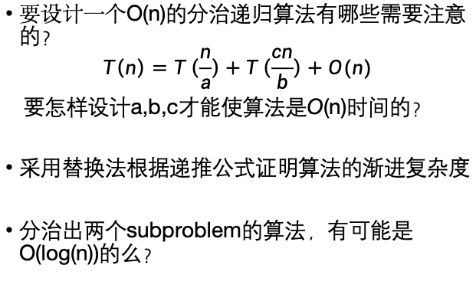
我们总结一下
要设计一个O(n)的分治递归算法有哪些需要注意的？
$$T\left(n\right)=T\left(\frac{n}{a}\right)+T\left(\frac{cn}{b}\right)+O(n)$$
要怎样设计a,b,c才能使算法是O(n)时间的？
采用替换法根据递推公式证明算法的渐进复杂度
分治出两个subproblem的算法，有可能是O(log(n))的么？

Slide 55
In practice?
With not-very-slick implementation, our fancy version of SELECT is worse than the MergeSort-based SELECT ☹
But O(n) is better than O(n log(n))! How can that be?
What’s the constant in front of the n in our proof? 20? 30?
On non-adversarial inputs, random pivot choice is much better.
Moral:
Just pick a random pivot if you don’t expect nefarious arrays.
Optimize the implementation of SELECT (with the fancy pivot). Can you beat MergeSort?
Siggi the Studious Stork

Slide 56
主要内容
复习主定理和替换法
k-SELECT problem
D-Select (确定性算法)
R-Select, QuickSort(随机算法)

Slide 57
Random Select: RSelect(A, i)

Slide 58
a better explained randomized algorithm: QuickSort
Expected runtime O(nlog(n)).
Worst-case runtime O(n²).
In practice works great!
QuickSort uses very similar methods to the Select algorithm we saw last time. Can you modify the QuickSort algorithm we’ll learn today to make sure its worst-case runtime is O(nlog(n))?
Siggi the Studious Stork

Slide 59
Quicksort
For the rest of the lecture, assume all elements of A are distinct.
We want to sort this array.
First, pick a “pivot.”
Do it at random.
7
6
3
5
1
2
4
7
6
3
5
1
2
4
This PARTITION step takes time O(n). (Notice that we don’t sort each half).
[same as in SELECT]
Next, partition the array into “bigger than 5” or “less than 5”
random pivot!
Arrange them like so:
L = array with things smaller than A[pivot]
R = array with things larger than A[pivot]
Recurse on
L and R:
1
2
3
4
5
6
7

Slide 60
PseudoPseudoCode for what we just saw
Lecture 5 Python notebook for actual code.
QuickSort(A):
If len(A) <= 1:
return
Pick some x = A[i] at random. Call this the pivot.
PARTITION the rest of A into:
L (less than x) and
R (greater than x)
Replace A with [L, x, R] (that is, rearrange A in this order)
QuickSort(L)
QuickSort(R)
Assume that all elements of A are distinct. How would you change this if that’s not the case?

Slide 61
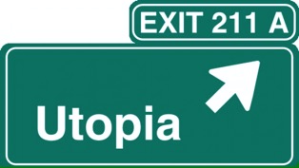
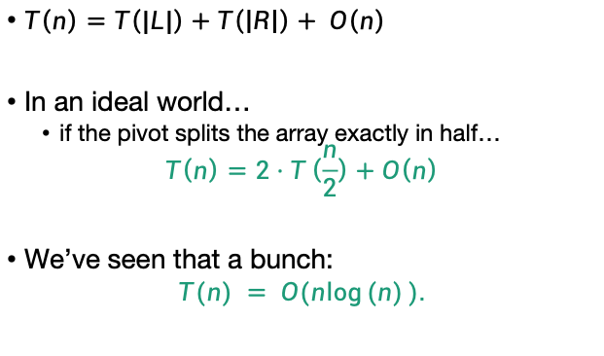
Running time?
$T\left(n\right)=T\left(|L|\right)+T\left(\left|R\right|\right)+ O\left(n\right)$
In an ideal world…
if the pivot splits the array exactly in half…
$$T\left(n\right)=2⋅T\left(\frac{n}{2}\right)+O\left(n\right)$$
We’ve seen that a bunch:
$$T(n) = O(n\log{(n)}).$$

Slide 62
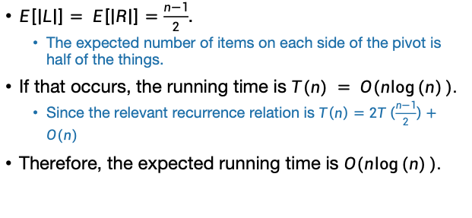
The expected running time of QuickSort is O(nlog(n)).
*
Proof:
$E\left[\left|L\right|\right]= E\left[\left|R\right|\right]=\frac{n−1}{2}$.
The expected number of items on each side of the pivot is half of the things.
If that occurs, the running time is $T(n) = O(n\log{(n)}).$
Since the relevant recurrence relation is $T\left(n\right)=2T\left(\frac{n−1}{2}\right)+O(n)$
Therefore, the expected running time is $O(n\log{(n)}).$
*Disclaimer: this proof is WRONG.

Slide 63
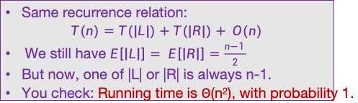
Red flag
Slow
QuickSort(A):
If len(A) <= 1:
return
Pick some x = A[i] at random. Call this the pivot.
PARTITION the rest of A into:
L (less than x) and
R (greater than x)
Replace A with [L, x, R] (that is, rearrange A in this order)
QuickSort(L)
QuickSort(R)
We can use the same argument to prove something false.
Pick the pivot x to be either max(A) or min(A), randomly
\\ We can find the max and min in O(n) time
Slow
Same recurrence relation:
$$T\left(n\right)=T\left(|L|\right)+T\left(\left|R\right|\right)+ O\left(n\right)$$
We still have $E\left[\left|L\right|\right]= E\left[\left|R\right|\right]=\frac{n−1 }{2}$
But now, one of |L| or |R| is always n-1.
You check: Running time is $Θ$(n²), with probability 1.
Slow

Slide 64
SlowSort的期望运行时间仍然是 O(nlog(n)).
What’s wrong???
1 minutes: think
1 minute: (wait) share
*
Proof:
$E\left[\left|L\right|\right]= E\left[\left|R\right|\right]=\frac{n−1}{2}$.
The expected number of items on each side of the pivot is half of the things.
If that occurs, the running time is $T(n) = O(n\log{(n)}).$
Since the relevant recurrence relation is $T\left(n\right)=2T\left(\frac{n−1}{2}\right)+O(n)$
Therefore, the expected running time is $O(n\log{(n)}).$
*Disclaimer: this proof is WRONG.

Slide 65
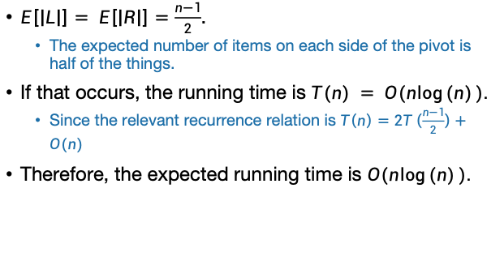
哪里错了呢？
$E\left[\left|L\right|\right]= E\left[\left|R\right|\right]=\frac{n−1}{2}$.
The expected number of items on each side of the pivot is half of the things.
If that occurs, the running time is $T(n) = O(n\log{(n)}).$
Since the relevant recurrence relation is $T\left(n\right)=2T\left(\frac{n−1}{2}\right)+O(n)$
Therefore, the expected running time is $O(n\log{(n)}).$
刚好左右各一半是期望场景，但不一定发生，这种情况下的时间不是期望运行时间
That’s not how expectations work!
“期望场景” 下的运行时间不是预期运行时间。
Sort of like how E[X²] is not the same as (E[X])²
Plucky the Pedantic Penguin

Slide 66
所以
在计算期望运行时间时，要避免简单的使用期望场景的运行时间评估算法的期望运行时间。
正确的方式:
详细分析算法的可能的各种运行情况，采用统计分析的方法，计算算法的期望运行时间。

Slide 67
Example of recursive calls
7
6
3
5
1
2
4
Pick 5 as a pivot
3
1
2
4
5
7
6
Partition on either side of 5
Recurse on [3142] and pick 3 as a pivot.
3
1
2
4
5
7
6
Recurse on [76] and pick 6 as a pivot.
Partition around 3.
1
2
3
4
5
6
7
Partition on either side of 6
Recurse on [12] and pick 2 as a pivot.
1
2
3
4
5
6
7
Recurse on [7], it has size 1 so we’re done.
Recurse on [4] (done).
1
2
3
4
5
6
7
partition around 2.
1
2
3
4
5
6
7
Recurse on [1] (done).

Slide 68
How long does this take to run?
We will count the number of comparisons that the algorithm does.
This turns out to give us a good idea of the runtime. (Not obvious).
How many times are any two items compared?
7
6
3
5
1
2
4
In the example before, everything was compared to 5 once in the first step….and never again.
3
1
4
2
5
7
6
3
1
2
4
5
7
6
But not everything was compared to 3.
5 was, and so were 1,2 and 4.
But not 6 or 7.
1
2
3
4
5
6
7

Slide 69
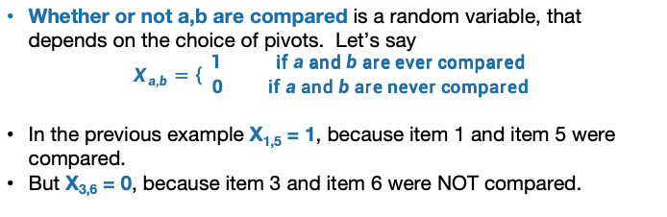
Each pair of items is compared either 0 or 1 times. Which is it?
7
6
3
5
1
2
4
Let’s assume that the numbers in the array are actually the numbers 1,…,n
Of course this doesn’t have to be the case! It’s a good exercise to convince yourself that the analysis will still go through without this assumption.
Whether or not a,b are compared is a random variable, that depends on the choice of pivots. Let’s say
$$X_{a,b}=\left\{\begin{aligned}1 \text{if} a \text{and} b \text{are} \text{ever} \text{compared} \\ 0 \text{if} a \text{and} b \text{are} \text{never} \text{compared} \end{aligned}\right.$$
In the previous example X_{1,5} = 1, because item 1 and item 5 were compared.
But X_{3,6} = 0, because item 3 and item 6 were NOT compared.

Slide 70
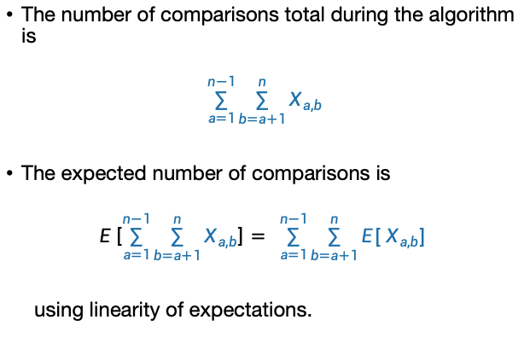
比较次数的统计分析
The number of comparisons total during the algorithm is
$$\sum_{a=1}^{n−1}{\sum_{b=a+1}^{n}{X_{a,b}}}$$
The expected number of comparisons is
$$E\left[\sum_{a=1}^{n−1}{\sum_{b=a+1}^{n}{X_{a,b}}}\right]= \sum_{a=1}^{n−1}{\sum_{b=a+1}^{n}{{E[ X}_{a,b}] }}$$
using linearity of expectations.
计算任何两个数被比较的次数之和

Slide 71

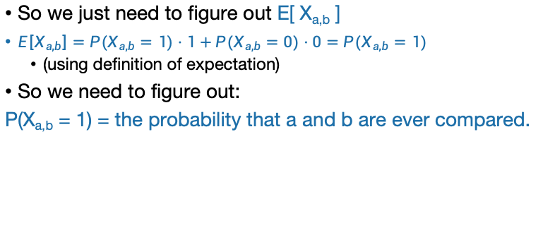
Counting comparisons
expected number of comparisons:
$$\sum_{a=1}^{n−1}{\sum_{b=a+1}^{n}{{E[ X}_{a,b}] }}$$
So we just need to figure out E[ X_{a,b} ]
$E\left[X_{a,b}\right]=P(X_{a,b}=1)⋅1+P(X_{a,b}=0)⋅0=P(X_{a,b}=1)$
(using definition of expectation)
So we need to figure out:
P(X_{a,b} = 1) = the probability that a and b are ever compared.
7
6
3
5
1
2
4
考虑a=2，b=6，2和6被比较的概率是多少？
7
6
3
5
1
2
4
这正是从高亮显示的几个数字中首先选择2或6做pivot的概率，为什么呢？
3
1
2
4
5
7
6
比如说，如果先选了5，那么2个和6个就会被分开，再也见不到对方，不会相互比较。

Slide 72
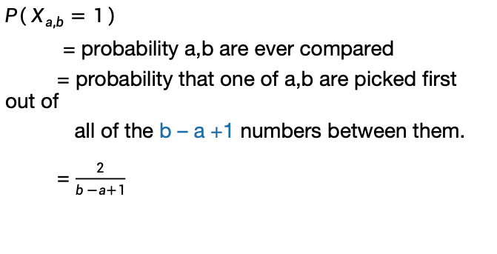
Counting comparisons
$P\left( X_{a,b}=1 \right)$
= probability a,b are ever compared
= probability that one of a,b are picked first out of
all of the b – a +1 numbers between them.
= $\frac{2}{b −a+1}$
2 choices out of b-a+1…
我们为什么不关心1,7呢？
7
6
3
5
1
2
4
因为选择1,7与2和6是否比较是无关的。

Slide 73
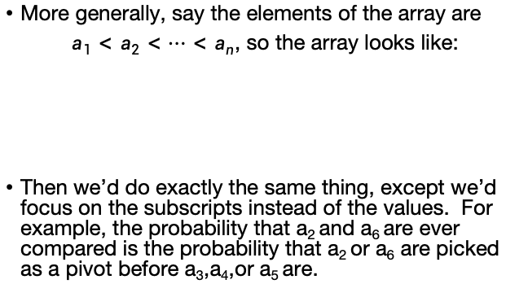
Aside: Why can we assume that the elements of the array are {1,2,..,n}?
Slide skipped in class
More generally, say the elements of the array are
$a_{1}<a_{2}<⋯<a_{n}$, so the array looks like:
Then we’d do exactly the same thing, except we’d focus on the subscripts instead of the values. For example, the probability that a₂ and a₆ are ever compared is the probability that a₂ or a₆ are picked as a pivot before a₃,a₄,or a₅ are.
a₇
a₆
a₃
a₅
a₁
a₂
a₄

Slide 74
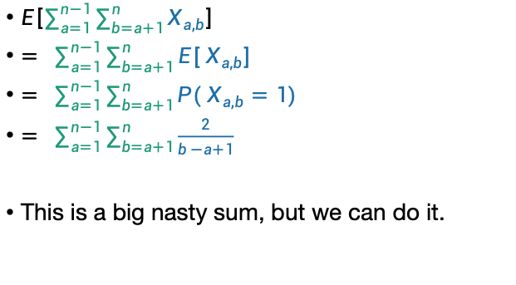
All together now… Expected number of comparisons
This is the expected number of comparisons throughout the algorithm
$E\left[\sum_{a=1}^{n−1}{\sum_{b=a+1}^{n}{X_{a,b}}}\right]$
$= \sum_{a=1}^{n−1}{\sum_{b=a+1}^{n}{{E[ X}_{a,b}] }}$
$= \sum_{a=1}^{n−1}{\sum_{b=a+1}^{n}{{P( X}_{a,b}=1) }}$
$= \sum_{a=1}^{n−1}{\sum_{b=a+1}^{n}{\frac{2}{b −a+1}}}$
This is a big nasty sum, but we can do it.
linearity of expectation
definition of expectation
the reasoning we just did
Do this sum!
Ollie the over-achieving ostrich

Slide 75

Expected number of comparisons
$$≤2\left(\frac{1}{2}+\frac{1}{3}+⋯+\frac{1}{n}\right)$$
我们想基于这个式子找一个时间复杂度的上界，所以：

Slide 77
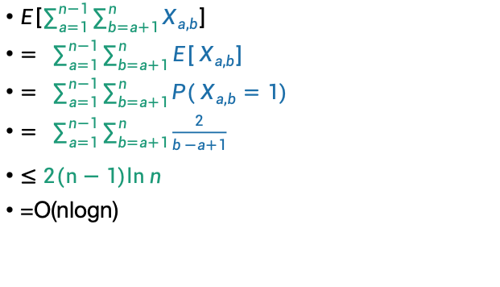
Expected number of comparisons
$E\left[\sum_{a=1}^{n−1}{\sum_{b=a+1}^{n}{X_{a,b}}}\right]$
$= \sum_{a=1}^{n−1}{\sum_{b=a+1}^{n}{{E[ X}_{a,b}] }}$
$= \sum_{a=1}^{n−1}{\sum_{b=a+1}^{n}{{P( X}_{a,b}=1) }}$
$= \sum_{a=1}^{n−1}{\sum_{b=a+1}^{n}{\frac{2}{b −a+1}}}$
$≤$ $2(n−1)ln{n}$
=O(nlogn)

Slide 78
Almost done
We saw that E[ number of comparisons ] = O(n log(n))
Is that the same as E[ running time ]?
QuickSort(A):
If len(A) <= 1:
return
Pick some x = A[i] at random. Call this the pivot.
PARTITION the rest of A into:
L (less than x) and
R (greater than x)
Replace A with [L, x, R] (that is, rearrange A in this order)
QuickSort(L)
QuickSort(R)
In this case, yes.
We need to argue that the running time is dominated by the time to do comparisons.
See lecture notes.

Slide 79
The running time is dominated by the time to do comparisons
In each recursive call on an array of size k, the algorithm performs k − 1 comparisons in order to split the array, and the amount of work done is O(k).
These comparisions are counted in C.
Quicksort will be called on single-element arrays at most once for each element in the original array.
So the total running time of Quicksort is O(C + n).
In conclusion, the expected running time of Quicksort on worst-case input is O(n log n)

Slide 80
Worst-case running time
Suppose that an adversary is choosing the “random” pivots for you.
Then the running time might be O(n²)
E.g., they’d choose to implement SlowSort
In practice, this doesn’t usually happen.

Slide 81

总结
D-Select: 确定性算法
不对称划分的分治递归算法的渐进时间复杂度分析，用替换法分析证明。
QuickSort: 随机算法
随机算法的期望时间复杂度分析，并非期望场景的时间复杂度。
$$T\left(n\right)≤T\left(\frac{n}{5}\right)+T\left(\frac{7n}{10}\right)+O(n)$$
$$E\left[\sum_{a=1}^{n−1}{\sum_{b=a+1}^{n}{X_{a,b}}}\right]$$

Slide 82
算法设计分析与算法实现关系
希望大家提升到算法的设计、分析、理论性证明的“术”的层面。
实现的“技”也很重要，大家需要继续锻炼数据结构、程序设计的基础，提高实现能力。
在以后的实际工作科研中，可以广泛使用STL等基础数据结构和基础算法，所以实际工作中对于求解复杂问题的算法设计与分析是更为重要的。
但是基础是重要的，不能只是用，知道基础的东西是怎么来的，才能创造。

